Slide 1
OS’23 Project
Milestone 2: MEMORY
KERNEL HEAP, USER HEAP & FAULT HANDLER I

Slide 2

Agenda
Logistics
Part 0: Code Updates
Part 1: Kernel Heap
Block Allocator
Page Allocator
Part 2: Fault Handler I
Part 3: User Heap
Block Allocator
Page Allocator
Summary & Quick Guide
How to submit?

Slide 3
Logistics
Dependency:
MS1: dynamic allocator (alloc_block_FF & free_block)
Delivery Method: GOOGLE FORMS
It’s FINAL delivery
MUST deliver the required tasks and ENSURE they’re worked correctly
Delivery Dates:
SAT of Week #9 (25/11 @11:59 PM)
Upload your code EARLY as NO EXCEPTION will be accepted.
Support:
The support for teams will be through their MENTORS ONLY (+Lecturer) during the published weekly office hours.

Slide 4
Logistics
ADVICE#1: WORK AS A TEAM
Milestone 2: MEMORY
Kernel Heap: 6 functions
User Heap: 7 functions
Fault Handler I: 3 functions
Average # Functions / Member = 16 / 5 members
ADVICE#2: START immediately!
To have the chance to ask and to understand errors in your code in whatever you want during your mentor’s support before the deadline.
ADVICE#3: MUST read the ppt & doc CAREFULLY
Detailed steps
Helper ready made functions (appendices)
≈ 3 Functions on 2 Weeks

Slide 5
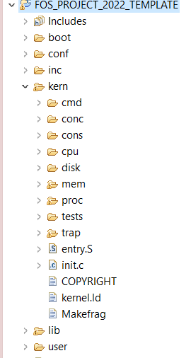




PROJECT BIG PICTURE
inc (.h)
Kern Heap
User Heap
lib (.c)
Fault Handler
User Heap
[MS1] Preprocessing
user
kern
[MS2] MEMORY
Kern Heap
[MS3] CPU
Fault Handler I
User Heap

Slide 6
Code Updates
PART0: PREREQUISITES

Slide 7
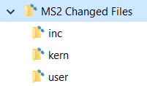
New Files
SELECT ALL in the given “Changed files” folder,
COPY & PASTE (REPLACE ALL) in FOS_CODES/FOS_PROJECT_2023_TEMPLATE/
NOTE: If any of these files are already edited by you in MS1, make sure to apply the edits in the new files

Slide 8
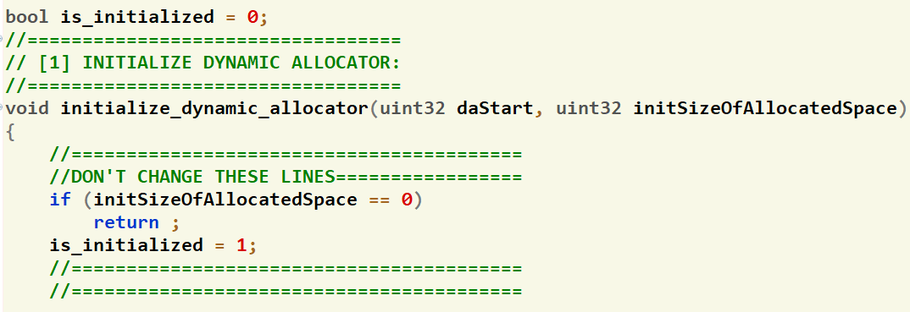
Code Modification
Inside lib/dynamic_allocator.c, apply the following changes:
Modify the beginning of initialize_dynamic_allocator() function
Notes:
if (!is_initialized)
{
uint32 required_size = size + sizeOfMetaData();
uint32 da_start = (uint32)sbrk(required_size);
//get new break since it's page aligned! thus, the size can be more than the required one
uint32 da_break = (uint32)sbrk(0);
initialize_dynamic_allocator(da_start, da_break - da_start);
}

Slide 9
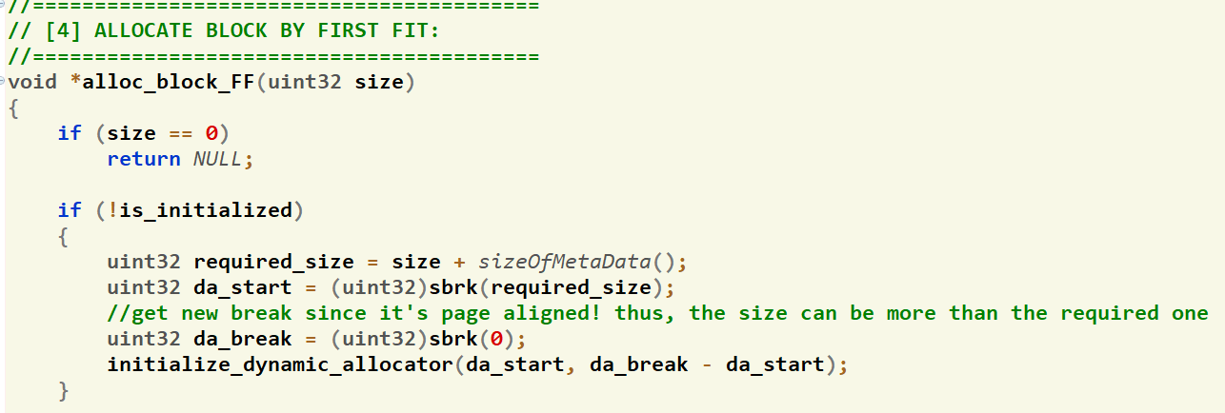
Code Modification
Inside lib/dynamic_allocator.c, apply the following changes:
Add the following code to the beginning of alloc_block_FF() function
If the dynamic allocator is NOT initialized (init size=0),
extend it by sbrk() then
reinitialize it with the new allocated area
CODE
In
NOTES
Notes:
if (!is_initialized)
{
uint32 required_size = size + sizeOfMetaData();
uint32 da_start = (uint32)sbrk(required_size);
//get new break since it's page aligned! thus, the size can be more than the required one
uint32 da_break = (uint32)sbrk(0);
initialize_dynamic_allocator(da_start, da_break - da_start);
}

Slide 10

Corner Case
In alloc_block_FF() function:
After allocating a block larger than the required size
If the remaining free space *doesn’t fit* a meta data struct,
then this area should be added to the size of allocated block and counted as *internal fragmentation*
meta data
$$≠$$
meta data
meta data
rem
size + rem
size
ptr1
ptr1 = alloc_FF (size)
meta data
meta data
.
.
.
meta data
daStart
Notes:
if (!is_initialized)
{
uint32 required_size = size + sizeOfMetaData();
uint32 da_start = (uint32)sbrk(required_size);
//get new break since it's page aligned! thus, the size can be more than the required one
uint32 da_break = (uint32)sbrk(0);
initialize_dynamic_allocator(da_start, da_break - da_start);
}

Slide 11
Given Codes
APPENDICES:
ENTRY MANIPULATION in TABLES and DIRECTORY
PAGE FILE HELPER FUNCTIONS
WORKING SET STRUCTURE & HELPER FUNCTIONS
MEMORY MANAGEMENT FUNCTIONS
COMMANDs

Slide 12
Given Codes
MEMORY MANAGEMENT FUNCTIONS: [Detailed Explanation in Lab#3]
Function | Description
PDX(uint32 virtual address) | Gets the page directory index in the given virtual address (10 bits from 22 – 31).
PTX(uint32 virtual address) | Gets the page table index in the given virtual address (10 bits from 12 – 21).
ROUNDUP(uint32 value, uint32 align) | Rounds a given “value” to the nearest upper value that is divisible by “align”.
ROUNDDOWN (uint32 value, uint32 align) | Rounds a given “value” to the nearest lower value that is divisible by “align”.
tlb_invalidate (uint32* directory, uint32 virtual address) | Refresh the cache memory (TLB) to remove the given virtual address from it.
isKHeapPlacementStrategyFIRSTFIT() | Check which strategy is currently selected using the given functions.

Slide 13
Given Codes
MEMORY MANAGEMENT FUNCTIONS: [Detailed Explanation in Lab#4]
Function Name | Description
allocate_frame | Used to allocate a free frame from the free frame list
free_frame | Used to free a frame by adding it to free frame list
map_frame | Used to map a single page with a given virtual address into a given allocated frame, simply by setting the directory and page table entries
get_page_table | Get a pointer to the page table if exist
create_page_table | Create a new page table by allocating a new page at the kernel heap, zeroing it and finally linking it with the directory
unmap_frame | Used to un-map a frame at the given virtual address, simply by clearing the page table entry
get_frame_info | Used to get both the page table and the frame of the given virtual address

Slide 14

Agenda
Logistics
Part 0: Code Updates
Part 1: Kernel Heap
Block Allocator
Page Allocator
Part 2: Fault Handler I
Part 3: User Heap
Block Allocator
Page Allocator
Summary & Quick Guide
How to submit?

Slide 15
Kernel Heap
The main functions required by MS2 to handle “Kernel Heap” are:
# | Function | File
1 | Initialization | All essential declarations in: Kern/mem/kheap.h Functions definitions TO DO in: Kern/mem/kheap.c
2 | sbrk()
3 | kmalloc (using FIRST FIT)
4 | kfree
5 | kheap_virtual_address
6 | kheap_physical_address
MS2 BONUS 1 | krealloc (using BEST fit)

Slide 16
Kernel Heap
IMPORTANT NOTE
Before starting in the KHEAP functions, you MUST DO the following:
- Go to 'inc/memlayout.h' and set USE_KHEAP by 1

Slide 17

Kernel Heap – What is new?
Current:
Kernel is one-to-one mapped to 256 MB RAM
Kernel can’t directly access beyond 256 MB RAM
Problem:
Virtual Memory
4 GB
Physical Memory
FOS
256 MB
RAM
UP TO 4 GB
KERNEL_BASE
256 MB
0

Slide 18

Kernel Heap – What is new? (Cont.)
Example:
Kernel can’t directly access beyond 256 MB RAM
Because it is NOT
valid VA..
New_PT1
VA = KERNEL_BASE +512 MB!!
.
.
.
256 MB
New PT0
VA = KERNEL_BASE + 20 KB
New DIR
VA = KERNEL_BASE + 16 KB
PA = 512 MB
New PT1
Frame#131,072
.
.
.
KERNEL_BASE
PA = 20 KB
New PT0
Frame#5
PA = 16 KB
New DIR
Frame#4
Program’s Virtual Memory
PA = 0
RAM

Slide 19
Kernel Heap – What is new?
Solution:
Kernel Heap for dynamic allocations (No 1-1 map)
KERNEL’S TABLES
ptr_page_directory
PT#984
1023
Empty
984
Kernel Heap
500000
0
0
F#4
New PT0
VA = KHS + 4K
984
0
0
New DIR
VA = KHS
PA = 2 GB
NEW PT0
Frame#500,000
Index of Kernel Heap PT
KERNEL_BASE
.
.
.
.
.
.
PA = 16 KB
New DIR
Frame#4
KHS = KERNEL_HEAP_START
RAM
Program’s Virtual Memory

Slide 20
Kernel Heap – What is new? (Cont.)
KERNEL_HEAP_MAX
4 GB
KHEAP
KERNEL_HEAP_START
Kernel Heap lies at the end of the virtual space
256 MB
USTACKTOP
USTACKBOTTOM

Slide 21
Kernel Heap – Allocation Types?
There’re TWO types of allocator
Block Allocator
Used to allocate small blocks (with size LESS OR EQUAL DYN_ALLOC_MAX_BLOCK_SIZE)
Use Dynamic Allocator from MS#1
Range: [KERNEL_HEAP_START, HARD_LIMIT)
Page Allocator
Used to allocate chunk of pages (with size > DYN_ALLOC_MAX_BLOCK_SIZE )
Allocation is done on page boundaries (i.e. internal fragmentation)
Range: [HARD_LIMIT + PAGE_SIZE, KERNEL_HEAP_MAX)
KERNEL_HEAP_MAX
…
KERNEL HEAP
Page Allocator Area
HARD LIMIT + 4KB
HARD LIMIT
Block Allocator Area
KERNEL_HEAP_START
…

Slide 22
Kernel Heap – Block Allocator
Has 3 limits:
Start: begin of the dynamic allocator area
Break: end of current mapped area
Hard Limit: which the break can’t surpass
Break can only be changed using sbrk()
Use Dynamic Allocator with its data structure
HARD LIMIT
Block Allocator Area
KERNEL_HEAP_START
…

Slide 23
Kernel Heap – Block Allocator
“No Man’s Land” Problem
Since virtual address space is mapped in quanta of pages (multiple of 4KB).
When sbrk is called, the OS maps an entire page from RAM to the heap mapped region.
Now, it is possible that the break doesn’t end up exactly on a page boundary.
In this situation, this memory is accessible, even though it’s above break.
Bugs can occur, because no error will occur for read/write to this “no man’s land.”
Solution:
break MUST be ALGINED on page boundary

Slide 24
#1: KH Block Alloc Initialization
Description:
Need to keep track of 3 variables for the kernel dynamic allocator:
start,
segment break (end of the allocated space) and
hard limit (max limit that can’t be exceeded).
These should be declared in the kern/mem/kheap.h.
Initialize the 3 variables, together with the dynamic allocator itself inside:
int initialize_kheap_dynamic_allocator(…) defined in kern/mem/kheap.c
This function, in turn, is already called inside the FOS_initialize() in init.c

Slide 25
#1: KH Block Alloc Initialization
int initialize_kheap_dynamic_allocator(uint32 daStart, uint32 initSizeToAllocate, uint32 daLimit);
Description:
Initialize the block allocator of kernel heap with the given start address, size & limit
All pages in the given range should be allocated and mapped
Remember: call the initialize_dynamic_allocator(..) to complete the initialization
Return:
On success: 0
Otherwise (if no memory OR initial size exceed the given limit): E_NO_MEM
Testing:
Will be tested during the other tests…

Slide 26
#2: sbrk()
void* sbrk(int increment);
Description:
If increment > 0: if within the hard limit
move the segment break of the kernel to increase the size of its heap,
allocate pages and map them into the kernel virtual address space as necessary,
returns the address of the previous break (i.e. the beginning of newly mapped memory).
If increment = 0: just return the current position of the segment break
If increment < 0:
move the segment break of the kernel to decrease the size of its heap,
deallocate pages that no longer contain part of the heap as necessary.
returns the address of the new break (i.e. the end of the current heap space).
if no memory OR break exceed the hard limit: it should panic(…)

Slide 27
#2: sbrk()
void* sbrk(int increment);
Notes:
allocate or deallocate pages ONLY if the segment break crosses a page boundary
New segment break should be aligned on page-boundary to avoid "No Man's Land" problem
If failed to allocate additional pages for a kernel block allocator, for example,
the free frames are exhausted, or
the break exceed the limit of the dynamic allocator.
kernel should panic(...)

Slide 28
#2: sbrk()
void* sbrk(int increment);
In alloc_block_FF() of MS#1
after calling sbrk(), must check the new break since it's page aligned!
thus, the size can be more than the required one. If so, you need to handle it.
Testing:
=0 or >0: will be tested during the other tests…
< 0: [UNSEEN] test at your own…

Slide 29
Kernel Heap – Page Allocator
Should start at one-page after the block allocator limit
Allocation is done on page boundaries (multiple of 4KB)
i.e. internal fragmentation can occur
All required pages should be allocated & mapped by OS
Allocation Strategy: First Fit
KERNEL_HEAP_MAX
…
KERNEL HEAP
Page Allocator Area
HARD LIMIT + 4KB
KERNEL_HEAP_START
…

Slide 30

Kernel Heap – Page Allocator
Kmalloc(): dynamically allocate space
Kfree(): delete a previously allocated space
Kfree()
Remove ALL Pages BUT NOT Tables
kmalloc()
ALL Pages Created in Memory
KERNEL HEAP
RAM
HARD LIMIT + 4KB

Slide 31
Kernel Heap – Page Allocator
Allocate pages on 4KB granularity
.
.
.
ptr3 = kmalloc (3 KB)
ptr3
3 KB
ptr2 = kmalloc (1 KB)
ptr2
1 KB
2 KB
4 KB
ptr1 = kmalloc (6 KB)
ptr1
HARD LIMIT + 4KB
.
.
.

Slide 32
Kernel Heap – Page Allocator
.
.
.
KERNEL_HEAP_MAX
2 MB
FIRST FIT Strategy
.
.
.
ptr4 = kmalloc (2 MB)
2 MB
ptr4
1 MB
3 MB
4 MB
ptr2 = kmalloc (3 MB)
ptr2
2 MB
ptr3 = kmalloc(1 MB)
ptr3
1 MB
3 MB
ptr1 = kmalloc (1 MB)
ptr1
1 MB
4 MB
In kmalloc, you need to check which strategy is currently selected to apply its code using the given functions: isKHeapPlacementStrategyFIRSTFIT(), isKHeapPlacementStrategyBESTFIT(), …
HARD LIMIT + 4KB
.
.
.

Slide 33
Kernel Heap – Page Allocator
kheap_physical_address(): find physical address of the given kernel virtual address
kheap_virtual_address(): find kernel virtual address of the given physical one
IMP: Both MUST be Efficient ~O(1)
kheap_physical_address()
Get pa of the given va
kheap_virtual_address()
Get va of the given pa
KERNEL HEAP
RAM
pa
pa
va
va

Slide 34
#3: kmalloc()
void* kmalloc(unsigned int size)
Description:
If size ≤ DYN_ALLOC_MAX_BLOCK_SIZE: [BLOCK ALLOCATOR]
Use dynamic allocator with FIRST FIT to allocate the required space
Else: [PAGE ALLOCATOR]
Allocate & map the required space on page-boundaries using FIRST FIT strategy
If failed to allocate: return NULL
Testing:
FOS> tst kheap FF kmalloc 1 ➔ tests allocation only
FOS> tst kheap FF kmalloc 2 ➔ tests FF strategy #1 (depends on kfree)
FOS> tst kheap FF kmalloc 3 ➔ tests FF strategy #2 (depends on kfree)

Slide 35
#4: kfree()
void kfree(void* virtual_address)
Description:
If virtual address inside the [BLOCK ALLOCATOR] range
Use dynamic allocator to free the given address
If virtual address inside the [PAGE ALLOCATOR] range
FREE the space of the given address from RAM
Else (i.e. invalid address): should panic(…)
Testing:
FOS> tst kheap FF kfree

Slide 36
#5: kheap_physical_address()
unsigned int kheap_physical_address(unsigned int virtual_address)
Description:
return the physical address corresponding to given virtual_address (including offset)
If no mapping, return 0.
It should work for both [BLOCK ALLOCATOR] and [PAGE ALLOCATOR]
It should run in O(1)
Testing:
FOS> tst kheap FF kphysaddr

Slide 37
#6: kheap_virtual_address()
unsigned int kheap_virtual_address(unsigned int physical_address)
Description:
return the virtual address corresponding to given physical_address (including offset)
If no mapping, return 0.
It should work for both [BLOCK ALLOCATOR] and [PAGE ALLOCATOR]
It should run in O(1)
Testing:
FOS> tst kheap FF kvirtaddr

Slide 38
BONUS#1: krealloc()
void *krealloc(void *virtual_address, uint32 new_size)
Description:
Attempts to resize the allocated space at given virtual address to "new size" bytes, possibly moving it in the heap.
If successful, returns the new virtual address, in which case the old virtual address must no longer be accessed.
On failure, returns a null pointer, and the old virtual address remains valid.
A call with virtual_address = null is equivalent to kmalloc()
A call with new_size = zero is equivalent to kfree()
It should work for both [BLOCK ALLOCATOR] and [PAGE ALLOCATOR]
Testing:
[UNSEEN] test at your own

Slide 39
Kernel Heap – Testing
Test each function independently in a FRESH SEPARATE RUN.
The time limit of each individual test: max of 15 sec / each
Before testing any of the kheap functions:
Go to 'inc/memlayout.h' and set USE_KHEAP by 1
"Congratulations!! test [TEST NAME] completed successfully.”
To ensure the success of a test a congratulations message like this MUST be appeared without any ERROR messages or PANICs.

Slide 40
Kernel Heap – Testing
Dependency Graph:
Dynamic Allocator
Test kmalloc 1
Test kfree
Test kheap virtual addr.
Test kheap physical addr.
Test kmalloc 2
Test kmalloc 3

Slide 41
Agenda
Logistics
Part 0: Code Updates
Part 1: Kernel Heap
Block Allocator
Page Allocator
Part 2: Fault Handler I
Part 3: User Heap
Block Allocator
Page Allocator
Summary & Quick Guide
How to submit?

Slide 42
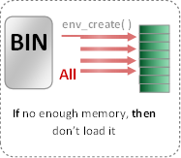
Load Program [env_create] [already DONE]
Now: in Project
Prev: in Labs
TWO kernel dynamic allocations:
create_page_table(): create new page table and link it to directory.
create_user_directory(): create new user directory.
env_create( )
BIN
Set of pages
Required Tables
All Pages
BIN
Segment 1, page 1
Loaded in virtual address 201000
201000
WS_Last_element
Segment 1, page 2
Loaded in virtual address 202000
202000
Refer to APPENDICES for:
Segment 1, page 3
203000
Loaded in virtual address 203000
Segment 2, page 1
801000
Page File Helper Functions
Loaded in virtual address 801000
Segment 2, page 2
USTAKTOP —PAGESIZE
NOT Loaded in main memory
Program Binary Segments and pages
Working Set after loading (pages_WS_size = 5)
Working Set Structure & Helper Functions
First Stack Page

Slide 43
Working Set: Structure
Each environment has a working set LIST (page_WS_list) that is initialized in env_create()
This list hold pointers of type struct WorkingSetElement containing info about the currently loaded pages in memory.
Each struct holds two important values about each page:
User virtual address of the page
Previous & Next pointers to be used by list

Slide 44
Working Set: Structure
The working set list is defined inside the environment structure “struct Env” located in inc/environment_definitions.h.
Its max size is set in "page_WS_max_size" during the env_create().
"page_last_WS_element" will point to either:
the next location in the WS after the last set one If list is full.
Null if the list is not full.

Slide 45
Working Set: Functions [GIVEN]
void env_page_ws_print(struct Env* e)
Print the page working set virtual addresses together with used, modified & buffered bits.
It also shows where the page_last_WS_element of the working set is point to

Slide 46
Working Set: Functions [GIVEN]
void env_page_ws_invalidate(struct Env* e, uint32 virtual_address)
Search for the given virtual address inside the working set of “e” , if found:
Remove its WS element from the list
Delete this element from the kernel memory (using kfree())

Slide 47
#7: env_page_ws_list_create_element()
struct WorkingSetElement* env_page_ws_list_create_element(struct Env* e, uint32 virtual_address)
Description:
Create a new object of struct WorkingSetElement
Initialize it by the given virtual address
Return
On success: pointer to the created object
On failure: kernel should panic()
Testing:
Already tested in next placement test

Slide 48
Fault Handler I: Introduction
The main functions required by MS3 to handle “Page Fault” are:
# | Function | File
1 | page_fault_handler | Functions definitions TO DO in: kern/trap/fault_handler.c

Slide 49
Fault Handler I: Introduction
Fault: is an exception thrown by the processor (MMU) to indicate that:
A page table is not exist in the main memory (i.e. new table). (see the following figure) OR
A page can’t be accessed due to either it’s not present in the main memory

Slide 50
#8: Check Invalid Pointers
void fault_handler(struct Trapframe *tf)
Description:
Validate the faulted_va to ensure that it is NOT:
pointing to unmarked page in user heap
pointing to kernel
exist but with read-only permissions
If invalid: it must be rejected without harm to the kernel or other running processes, by killing the process

Slide 51
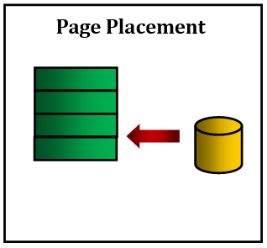
#9: Placement
page_fault_handler(struct Env * curenv, uint32 fault_va)
If the size of the page working LIST < its max size, then do (refer to appendices for helper functions)
Scenario 1: Placement
Allocate space for the faulted page
Read the faulted page from page file to memory
If the page does not exist on page file, then
If it is a stack or a heap page, then, it’s OK.
Else, it must be rejected without harm to the kernel or other running processes, by killing the process.
Reflect the changes in the page working set list (i.e. add new element to list & update its last one)
NOTE: Check MS2 appendices to handle either the working set or the page file using some ready-made functions.

Slide 52
Fault Handler I: Testing
Test each function in MS3 independently in a FRESH SEPARATE RUN
The time limit of each individual test: max of 10 sec / each
# | Test Functionality | Test
1 | tst_placement.c (tpp): tests page faults on stack + page placement | FOS> run tpp 20
2 | tst_invalid_access.c (tia): tests invalid pointers | FOS> run tia 15

Slide 53
Agenda
Logistics
Part 0: Code Updates
Part 1: Kernel Heap
Block Allocator
Page Allocator
Part 2: Fault Handler I
Part 3: User Heap
Block Allocator
Page Allocator
Summary & Quick Guide
How to submit?

Slide 54
User Heap
The main functions required by MS2 to handle “User Heap” are:
# | Function | File
1 | Initialization | All essential declarations in: inc/uheap.h Functions definitions TO DO in: lib/uheap.c
2 | sys_sbrk()
3 | NEW system call to get hard limit
4 | malloc() (using FIRST FIT) [USER SIDE]
5 | free() [USER SIDE]
6 | Allocate_user_mem [KERNEL SIDE] | Kern/mem/chunk_operations.c
7 | free_user_mem [KERNEL SIDE]
MS2 BONUS 2 | free_user_mem: O(1) for removing pages from WS List

Slide 55
User Heap
IMPORTANT NOTE
ALL Functions Depend on the Implementation of Page Fault Placement

Slide 56
User Heap: Overview
Before we start!
Program runs in user mode (less privileges)
It requires functions from the kernel
So, need to switch to kernel mode, call the function, then return to user mode
SYSTEM CALLS (S/W interrupts) do this job!

Slide 57
User Heap: Overview
WHY?
Program need dynamic allocations for its normal work
De-allocations are necessary after finishing using allocated memory:
virtual address space fragmentation happens
Minimize virtual addresses fragmentation as possible

Slide 58
User Heap: Overview
Allocation
Example 1 (C++ and C):
C++: int * ptr_value = new int;
C: int * ptr_value = malloc(sizeof(int));
allocate 1 int (4 bytes) in virtual memory and return the allocated virtual address to “ptr_value”
Example 2 (C++ and C):
C++: float* arr = new float[200];
C: float* arr = malloc(sizeof(float) * 200);
allocate 200 floats (800 bytes) in memory and return the allocated address to “arr”

Slide 59
User Heap: Overview
De-allocation
Example 1 (C++ and C):
C++: delete ptr_value;
C: free(ptr_value);
deallocate (free) 1 int (4 bytes) from virtual memory at address “ptr_value”
Example 2 (C++ and C):
C++: delete[] arr;
C: free(arr);
de-allocate (free) 200 floats (800 bytes) from virtual memory at address “arr”

Slide 60
User Heap: Overview
User Dynamic malloc/free *
malloc( ) (First Fit)
free( )
Nothing Created in Memory
REMOVE Working Sets Pages in Given Range
REMOVE ALL Pages in Given Range
UN-MARK allocated pages in VM
Nothing Created in Page File
MARK allocated pages in VM

Slide 61
User Heap – Allocation Types?
There’re TWO types of allocator
Block Allocator
Used to allocate small blocks (with size LESS OR EQUAL DYN_ALLOC_MAX_BLOCK_SIZE)
Use Dynamic Allocator from MS#1
Use sys_sbrk() to extend/shrink the mapped area
Range: [USER_HEAP_START, HARD_LIMIT)
Page Allocator
Used to allocate chunk of pages (size > DYN_ALLOC_MAX_BLOCK_SIZE )
Allocation is done on page boundaries (i.e. internal fragmentation)
Range: [HARD_LIMIT + PAGE_SIZE, USER_HEAP_MAX)
USER_HEAP_MAX
…
USER HEAP
Page Allocator Area
HARD LIMIT + 4KB
HARD LIMIT
Block Allocator Area
REMEMBER: In both, NOTHING is actually allocated in RAM until the user access it. In this case, allocation will be done via Fault Handler
USER_HEAP_START
…

Slide 62
User Heap – Block Allocator
Has 3 limits:
Start: begin of the dynamic allocator area
Break: end of current mapped area
Hard Limit: which the break can’t surpass
Break can only be changed using sbrk() which already calls sys_sbrk() from Kernel*
Use Dynamic Allocator with its data structure
HARD LIMIT
Block Allocator Area
KERNEL_HEAP_START
*:check the sbrk() in lib/uheap.c
…

Slide 63
User Heap – Block Allocator
“No Man’s Land” Problem
Since virtual address space is mapped in quanta of pages (multiple of 4KB).
When sys_sbrk is called, the OS reserve an entire page to the mapped region.
Now, it is possible that the break doesn’t end up exactly on a page boundary.
In this situation, this memory is accessible, even though it’s above break.
Bugs can occur, because no error will occur for read/write to this “no man’s land.”
Solution:
break should be ALGINED on page boundary

Slide 64
#10: UH Block Alloc Initialization
Description:
Need to keep track of 3 variables for the user block allocator:
start,
segment break (end of the allocated space) and
hard limit (max limit that can’t be exceeded).
These should be declared in the struct Env defined in inc/environment_definitions.h.
Initialize the 3 variables, together with the dynamic allocator itself inside:
initialize_uheap_dynamic_allocator(…) defined in kern/proc/user_environment.c
This function, in turn, is already called inside the initialize_environment() in init.c.
REMEMBER: the initial size of the user block allocator should be 0.

Slide 65
#10: UH Block Alloc Initialization
void initialize_uheap_dynamic_allocator(struct Env* e, uint32 daStart, uint32 daLimit)
Description:
Initialize the block allocator of user heap of the given environ. “e” with the given start & limit
Call the initialize_dynamic_allocator(..) to complete the initialization
REMEMBER: there's no initial allocations for the block allocator of the user heap.
Testing:
Will be tested during the other tests…

Slide 66
#11: new SysCall to Get Hard Limit
Description:
Implement and handle a new system call to get the hard limit of the user block allocator
Refer to MS#1 for steps
Testing:
Will be tested during the other tests…

Slide 67
#12: sys_sbrk()
void* sys_sbrk(int increment);
Description:
If increment > 0: if within the hard limit
move the segment break of the current user environment to increase the size of its block allocator,
allocate NOTHING,
returns the address of the previous break (i.e. the beginning of newly mapped memory).
If increment = 0: just return the current position of the segment break
If increment < 0:
move the segment break of the current user environment to decrease the size of its block allocator,
deallocate pages that no longer contain part of the block allocator as necessary.
returns the address of the new break (i.e. the end of the current heap space).
if no memory OR break exceed the hard limit: it should return -1

Slide 68
#12: sys_sbrk()
void* sys_sbrk(int increment);
Notes:
allocate or deallocate pages ONLY if the segment break crosses a page boundary
New segment break should be aligned on page-boundary to avoid "No Man's Land" problem
As in real OS, allocate pages lazily. While sys_sbrk moves the segment break, pages are not allocated until the user program tries to access data (i.e. will be allocated via fault handler).
If failed to allocate additional pages for a user block allocator, for example,
the free frames are exhausted, or
the break exceed the limit of the block allocator.
function should return -1

Slide 69
User Heap – Page Allocator
Should start at one-page after the block allocator limit
Allocation is done on page boundaries (multiple of 4KB)
i.e. internal fragmentation can occur
NO pages will be allocated in RAM or Page File
Allocation Strategy: First Fit
USER_HEAP_MAX
…
USER HEAP
Page Allocator Area
HARD LIMIT + 4KB
USER_HEAP_START
…

Slide 70
User Heap – Page Allocator
Allocate pages on 4KB granularity
.
.
.
ptr3 = malloc (3 KB)
ptr3
3 KB
ptr2 = malloc (1 KB)
ptr2
1 KB
2 KB
4 KB
ptr1 = malloc (6 KB)
ptr1
HARD LIMIT + 4KB
.
.
.

Slide 71
User Heap – Page Allocator
.
.
.
USER_HEAP_MAX
2 MB
.
.
.
ptr4 = malloc (2 MB)
2 MB
ptr4
1 MB
3 MB
4 MB
FIRST FIT Strategy
ptr2 = malloc (3 MB)
ptr2
2 MB
ptr3 = malloc(1 MB)
ptr3
1 MB
3 MB
ptr1 = malloc (1 MB)
ptr1
1 MB
HARD LIMIT + 4KB
4 MB
.
.
.

Slide 72
#13: malloc()
void* malloc(unsigned int size)
Description:
If size ≤ DYN_ALLOC_MAX_BLOCK_SIZE: [BLOCK ALLOCATOR]
Use dynamic allocator with FIRST FIT to allocate the required space
Else: [PAGE ALLOCATOR]
[USER SIDE] lib/uheap.c:
Implement FIRST FIT strategy to search the page allocator for suitable space to the required allocation size (space should be on 4 KB BOUNDARY)
Call sys_allocate_user_mem() to mark the reserved space
If failed to allocate: return NULL

Slide 73
#14: allocate_user_mem()
void allocate_user_mem(struct Env* e, uint32 va, uint32 size)
Description:
[KERNEL SIDE] kern/mem/chunk_operations.c:
Mark the given range to indicate it’s reserved for the page allocator of this environment
NOTE: you can use create_page_table() to create non-exiting tables (if any)
Nothing Created in Memory
Nothing Created in Page File
MARK allocated pages in VM

Slide 74
#15: free()
void free(void* virtual_address)
Description:
If virtual address inside the [BLOCK ALLOCATOR] range
Use dynamic allocator to free the given address
If virtual address inside the [PAGE ALLOCATOR] range
[USER SIDE] lib/uheap.c:
Find the allocated size of the given virtual_address
Free this allocation from the page allocator of the user heap
Call “sys_free_user_mem()” to free the allocation from the memory & page file
Else (i.e. invalid address): should panic(…)

Slide 75
#16: free_user_mem()
void free_user_mem(struct Env* e, uint32 va, uint32 size)
Description:
[KERNEL SIDE] kern/mem/chunk_operations.c:
Unmark the given range to indicate it’s NOT reserved for the page allocator of this environment
Free ALL pages of the given range from the Page File (Check MS2 appendix for PAGE FILE)
Free ONLY pages that are resident in the working set from the memory (Check MS2 appendix for WS)
REMOVE Working Sets Pages in Given Range
REMOVE ALL Pages in Given Range
UN-MARK allocated pages in VM

Slide 76
BONUS#2: O(1) of free_user_mem
void free_user_mem(struct Env* e, uint32 va, uint32 size)
Description:
efficient O(1) implementation of removing page from WS List instead of searching the entire list
Testing:
[UNSEEN] test at your own

Slide 77
User Heap: Testing
Test each function in MS2 independently in a FRESH SEPARATE RUN.
The time limit of each individual test: max of 10 sec / each
# | Test Functionality | Test
1 | tst_malloc_1.c (tm1): tests malloc() & allocate_user_mem() in PAGE ALLOCATOR. It validates: return addresses from the malloc() NOTHING is allocated in page file or memory memory access (read & write) of the allocated spaces (placement of fault handler should work) number of allocated frames and the WS entries after each memory access | FOS> run tm1 3000
2 | tst_malloc_2.c (tm2): tests malloc() & sys_sbrk() in DYNAMIC ALLOCATOR. It validates: return addresses from the malloc() NOTHING is allocated in page file memory access (read & write) of the allocated spaces (placement of fault handler should work) number of allocated frames and the WS entries after each memory access | FOS> run tm2 3000

Slide 78
User Heap: Testing
Test each function in MS2 independently in a FRESH SEPARATE RUN.
The time limit of each individual test: max of 10 sec / each
# | Test Functionality | Test
3 | tst_free_1.c (tf1): tests the implementation free() & free_user_mem() in PAGE ALLOCATOR. It validates: number of freed frames by free_user_mem() Removing the allocated pages from working set (if any) memory access (read & write) of the removed spaces (should not be allowed) | FOS> run tf1 3000
4 | tst_free_2.c (tf2): tests the implementation free() in DYNAMIC ALLOCATOR. It validates: Coalesce (merge) cases after free Allocate after free in merged blocks number of freed frames (should not be affected) allocated pages in working set (should not be affected) | FOS> run tf2 3000
5 | tst_first_fit_1.c (tff1): tests the FIRST FIT strategy in PAGE ALLOCATOR. Tests both granted and non-granted requests. (It depends on free & free_user_mem). | FOS> run tff1 3000
6 | tst_first_fit_2.c (tff2): tests the FIRST FIT strategy in DYNAMIC ALLOCATOR. Tests both granted and non-granted requests. (It depends on free). | FOS> run tff2 10,000

Slide 79
User Heap: Testing Dependency Graph
Dynamic Allocator
Kernel Heap
PLACEMENT (tpp)
Invalid Access
(invalid ptrs)
Malloc1
(PAGE ALLOC)
Malloc2
(BLOCK ALLOC)
Free1
(PAGE ALLOC)
Free2
(BLOCK ALLOC)
First Fit 1
(PAGE ALLOC)
First Fit 2
(BLOCK ALLOC)

Slide 80

Agenda
Logistics
Part 0: Prerequisites
Pointers
LISTs in FOS
Part 1: Play with Code!
Strings
Command Prompt
Part 2: System Calls
Part 3: Dynamic Allocator
Summary & Quick Guide
How to submit?

Slide 81
Summary
Module | Function | Difficulty | Testing | Files
Kernel Heap | Initialization | L1 | UNSEEN – Test at your own | kern/mem/kheap.h & kheap.c
 | sbrk() | L2 | +ve: Tested in remaining tests -ve: UNSEEN – Test at your own | kern/mem/kheap.c
System Calls | kmalloc (FIRST FIT) | L3 | FOS> tst kheap FF kmalloc 1 ➔ tests allocation only FOS> tst kheap FF kmalloc 2 ➔ tests FF #1 (depends on kfree) FOS> tst kheap FF kmalloc 3 ➔ tests FF #2 (depends on kfree) | kern/mem/kheap.c
 | kfree | L2 | FOS> FOS> tst kheap FF kfree
 | kheap_virtual_address | L1 | FOS> FOS> tst kheap FF kvirtaddr
 | kheap_physical_address | L1 | FOS> FOS> tst kheap FF kphysaddr
"Congratulations!! test [TEST NAME] completed successfully.”
To ensure the test success, a congratulations message like this MUST appear without any ERROR messages or PANICs.

Slide 82
Summary
Module | Function | Difficulty | Testing | Files
Fault Handler | env_page_ws_list_create_element | L1 | Already tested in Placement test | Kern/mem/working_set_manager.c
 | Check Invalid Pointers | L1 | FOS> run tia 15 | Kern/trap/trap.c
 | Page_fault_handler | L2 | FOS> run tpp 20 | Kern/trap/fault_handler.c
"Congratulations!! test [TEST NAME] completed successfully.”
To ensure the test success, a congratulations message like this MUST appear without any ERROR messages or PANICs.

Slide 83
Summary
Module | Function | Difficulty | Testing | Files
User Heap | Initialization | L1 | Will be tested during the other tests | inc/environment_definitions.h kern/proc/user_environment.c
 | New SysCall to get Limit | L1 | Will be tested during the other tests | lib/syscall.c, kern/trap/trap.c, kern/trap/syscall.c, inc/syscall.h
 | sys_sbrk() | L2 | +ve: Tested in remaining tests -ve: UNSEEN – Test at your own | kern/trap/syscall.c
System Calls | malloc (FIRST FIT) | L3 | FOS> run tm1 ➔ malloc PAGE ALLOC FOS> run tm2 ➔ malloc BLOCK ALLOC FOS> run tf1 ➔ free PAGE ALLOC FOS> run tf2 ➔ free BLOCK ALLOC FOS> run tff1 ➔ FF PAGE ALLOC FOS> run tff2 ➔ FF BLOCK ALLOC | lib/uheap.c kern/mem/chunk_operations.c
 | allocate_user_mem() | L2
 | free | L2 | FOS> FOS> tst kheap FF kvirtaddr
 | free_user_mem() | L3 | FOS> FOS> tst kheap FF kphysaddr
"Congratulations!! test [TEST NAME] completed successfully.”
To ensure the test success, a congratulations message like this MUST appear without any ERROR messages or PANICs.

Slide 84
REMEMBER:
UPDATE YOUR CODE ACCORDING TO PREVIOUSLY DESCRIBED STEPS
READ ATATCHED APPENDICES FOR HELPER FUNCTIONS.

Slide 85
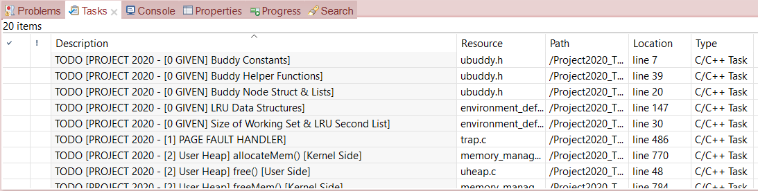
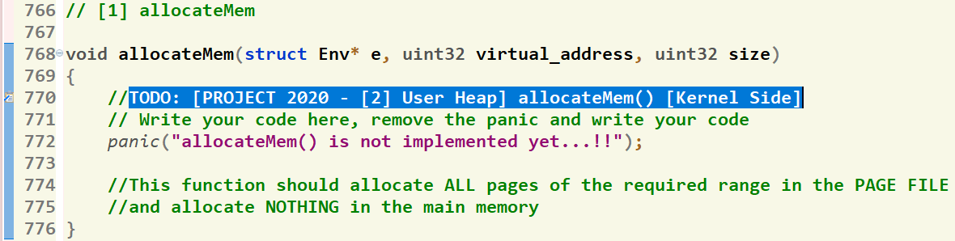
Where should I write the Code?
There’re shortcut links that direct you to the function definition
[1] Click on “Tasks” Tab
[2] Double Click on the required function
GIVEN
REQUIRED
[3] Function body, at which you should write the code
85

Slide 86
Agenda
Logistics
Part 0: Prerequisites
Pointers
LISTs in FOS
Part 1: Play with Code!
Strings
Command Prompt
Part 2: System Calls
Part 3: Dynamic Allocator
Summary & Quick Guide
How to submit?

Slide 87
Submission Rules
Read the following instructions as the code correction is done AUTOMATICALLY. Any violation in these rules will lead to 0 and, in this case, nothing could be happened.
First ensure the following that (READ CAREFULLY):
You tested each function in a FRESH RUN and a congratulations message have been appeared.
NO CODE with errors WILL BE CORRECTED. So, CLEAN & RUN your project several times before your submission.
You submitted BEFORE the deadline by several hours to AVOID any internet problems.
DEADLINE: SAT of Week #9 (25/11 @11:59 PM)
NO DELAYED submissions WILL BE ACCEPTED.
ONLY ONE person from the team shall submit the code.
The TEAM # MUST BE CORRECT.
DON’T take the FORM LINK FROM ANYONE. OPEN the form from its LINK ONLY. Otherwise, your submission is AUTOMATICALLY CANCELLED by GOOGLE.
You MUST RECEIVE A MAIL FROM GOOGLE with your submission after clicking submit. If nothing received, re-submit again to consider your submission.

Slide 88
Submission Steps
STEPS to SUBMIT:
Step 1: Clean & run your code the last time to ensure that there are any errors.
Step 2: Create a new folder and name it by your team number ONLY. Example 1 or 95. [ANY extra chars will lead to 0].
Step 3: DELETE the “obj” folder from the “FOS_PROJECT_2023_Template”
Step 4: PASTE the “FOS_PROJECT_2023_Template” in the folder created in step #2.
Step 5: Zip the created new folder. Its name shall be like [num of your team.zip]. [ANY extra chars will lead to ZERO].
Step 6: Open the form from HERE.
Step 7: Fill your team’s info .. Any wrong information will cancel your submission, revise them well.
Step 8: Upload the zipped folder in step 5 to the form in its field.
Step 9: MUST RECEIVE A MAIL from GOOGLE with your submission, otherwise re-submit again.

Slide 89
Thank you for your care…
Enjoy making your own FOS ☺

